Slide 1
✓
SafeCheck
Peace of mind when you travel alone
A two-stage safety check-in companion — product walkthrough

Slide 2
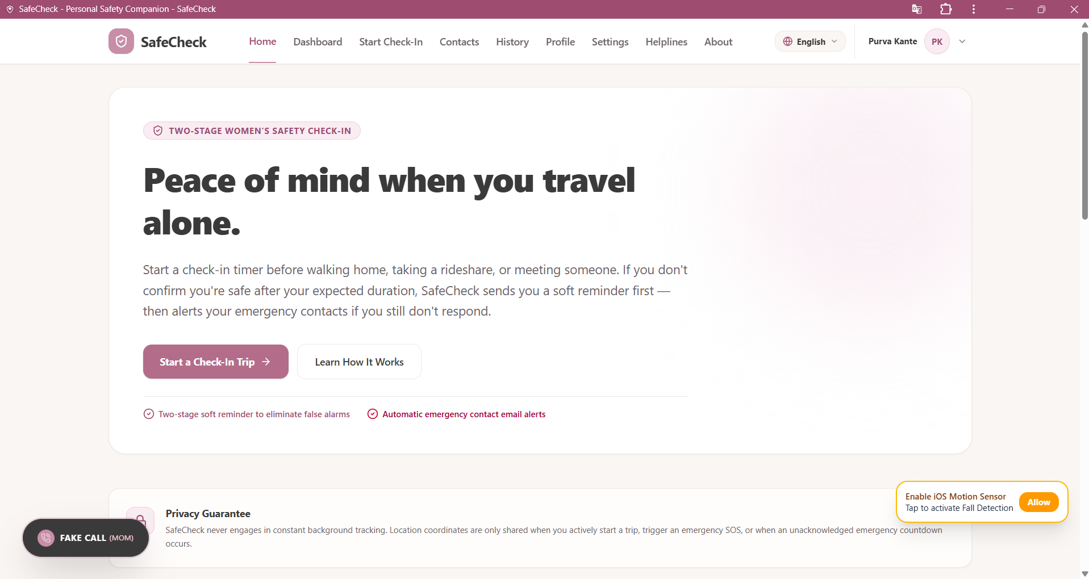
Why SafeCheck
Legacy panic buttons rely on intrusive constant tracking and trigger frequent false alarms that cause alert fatigue. SafeCheck rethinks the safety check-in from the ground up.
Two-stage check-in
A soft reminder first, then automatic emergency-contact alerts only if you stay unresponsive.
Privacy-first by design
No constant background tracking — location is only shared during an active trip or SOS.
One-tap Emergency SOS
Instantly alerts trusted contacts with a live GPS link, no setup required in the moment.
SafeCheck • Personal Safety Companion
2

Slide 3
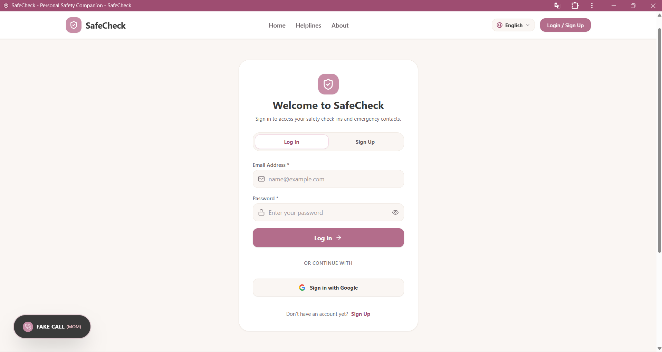
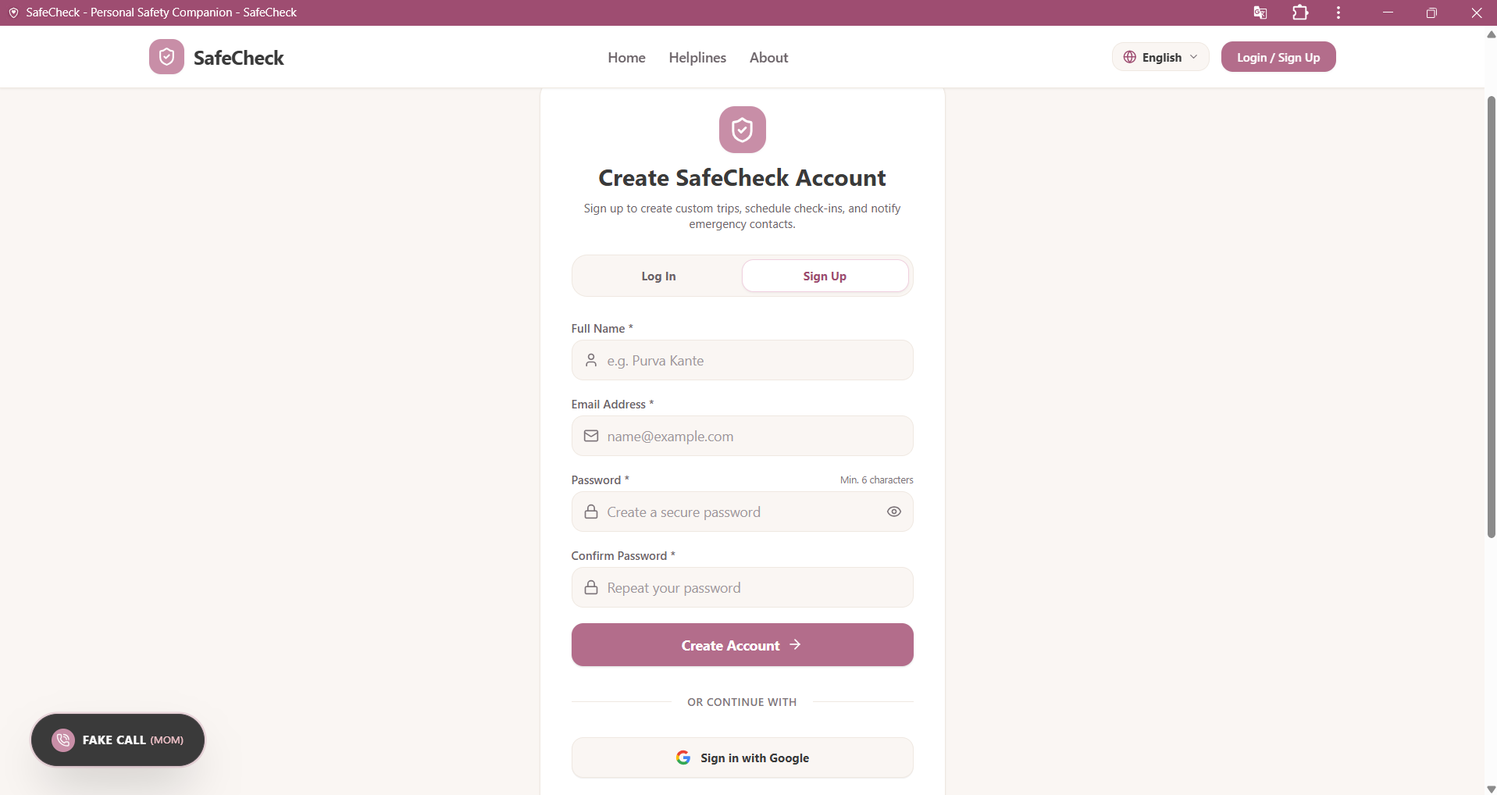
Getting Started
A simple, welcoming sign-up flow gets users protected in under a minute.
Log in
Create an account
SafeCheck • Personal Safety Companion
3

Slide 4
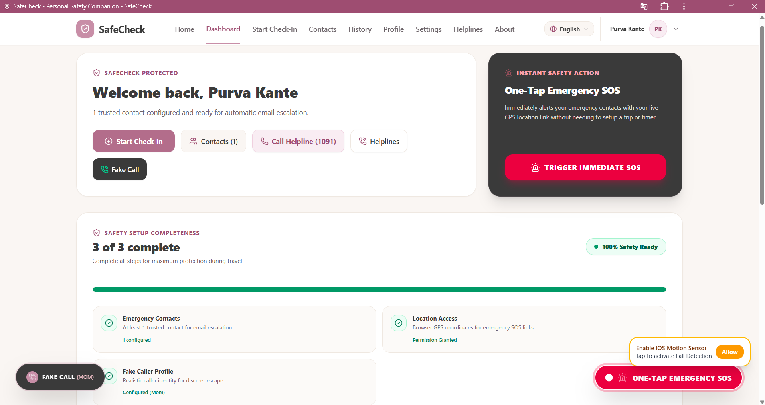
Your Safety Dashboard
Everything a user needs is one glance away — trusted contacts, quick helplines, and instant SOS.
One-Tap Emergency SOS
Immediately alerts contacts with a live GPS link — no trip setup needed.
Safety setup checklist
Guides users to add contacts, grant location access, and set a fake caller profile.
At-a-glance stats
Trips taken, safe arrivals, alerts triggered, and saved contacts, tracked automatically.
SafeCheck • Personal Safety Companion
4

Slide 5
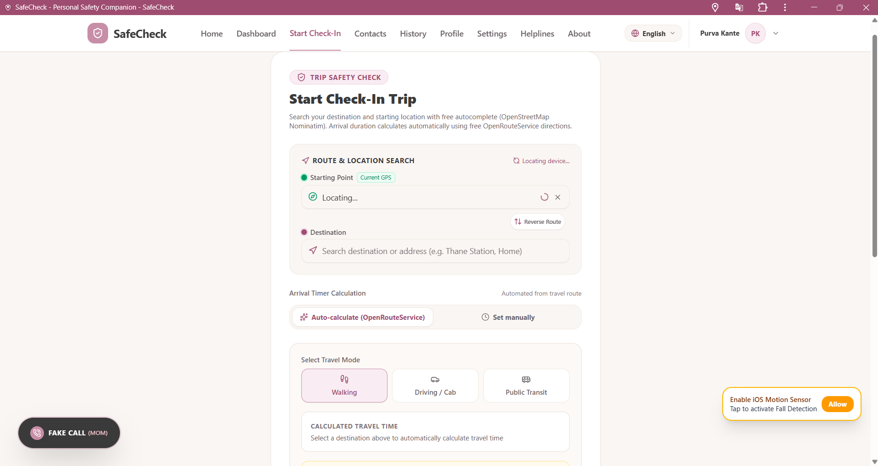
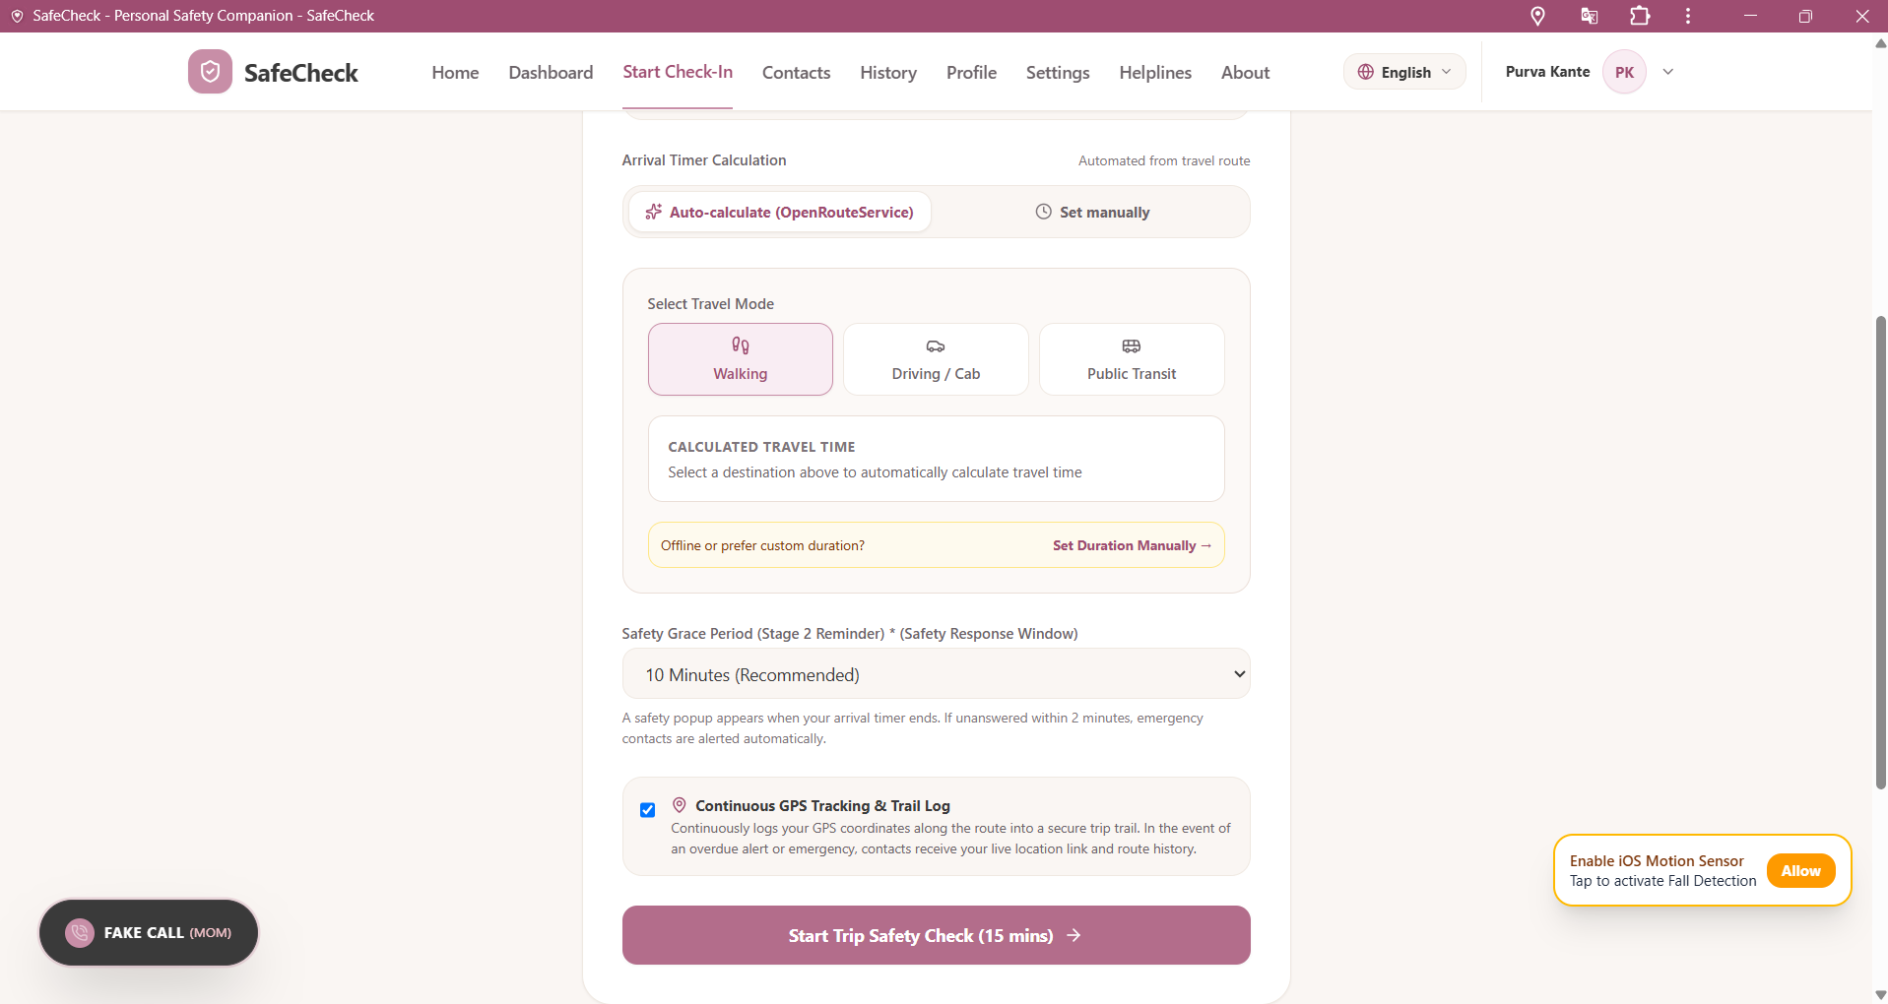
Start a Check-In Trip
Before walking home, taking a rideshare, or meeting someone new — start a timed check-in in seconds.
Route, destination & travel mode — arrival time is calculated automatically
Configurable safety grace period, with optional continuous GPS trail
SafeCheck • Personal Safety Companion
5

Slide 6
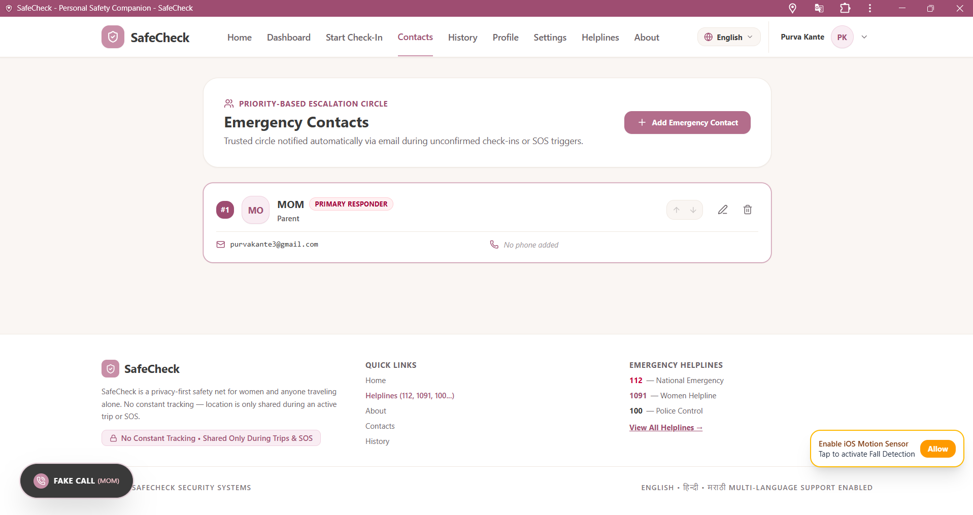
Emergency Contacts
A priority-based escalation circle, notified automatically during an unconfirmed check-in or SOS trigger.
Primary responder tagging
Mark a trusted contact as the first point of escalation.
Automatic email alerts
Contacts receive live location links only when it matters.
Always editable
Add, reorder, or remove contacts anytime from one screen.
SafeCheck • Personal Safety Companion
6

Slide 7
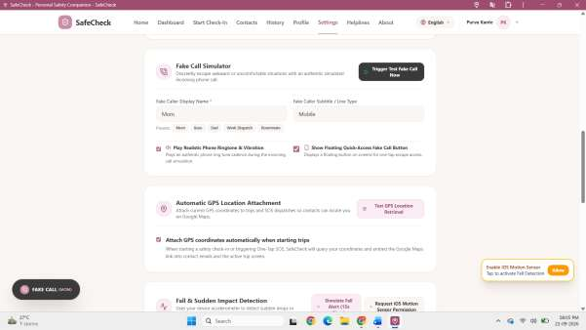
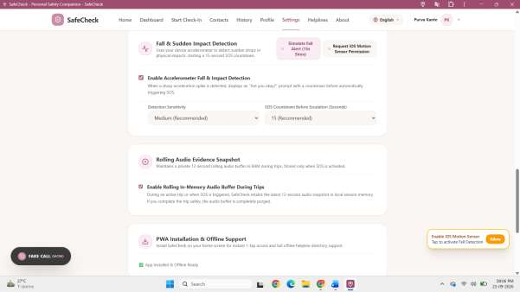
Smart Safety Features
Discreet tools that work quietly in the background, ready the moment they're needed.
Fake Call Simulator — escape uncomfortable situations with a realistic incoming call
Fall & impact detection — sudden drops trigger an SOS countdown automatically
SafeCheck • Personal Safety Companion
7

Slide 8
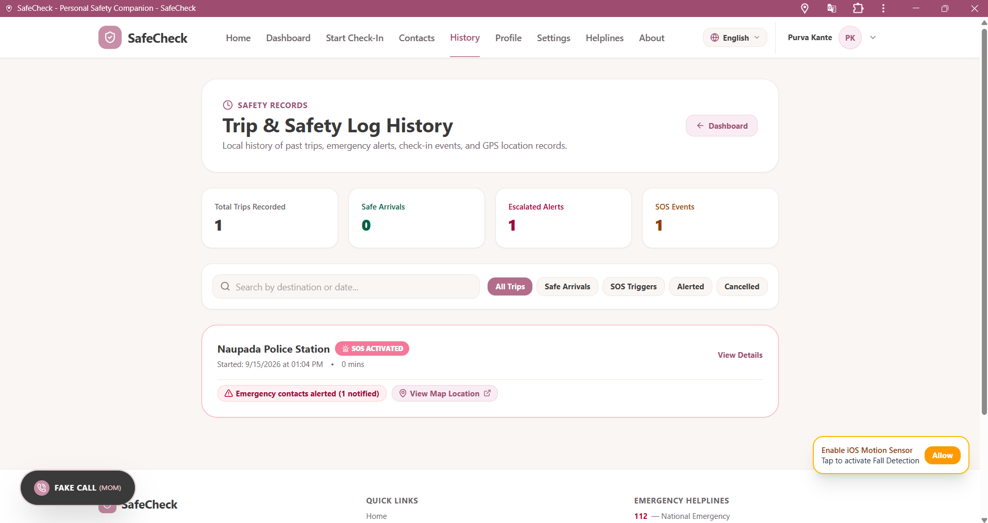
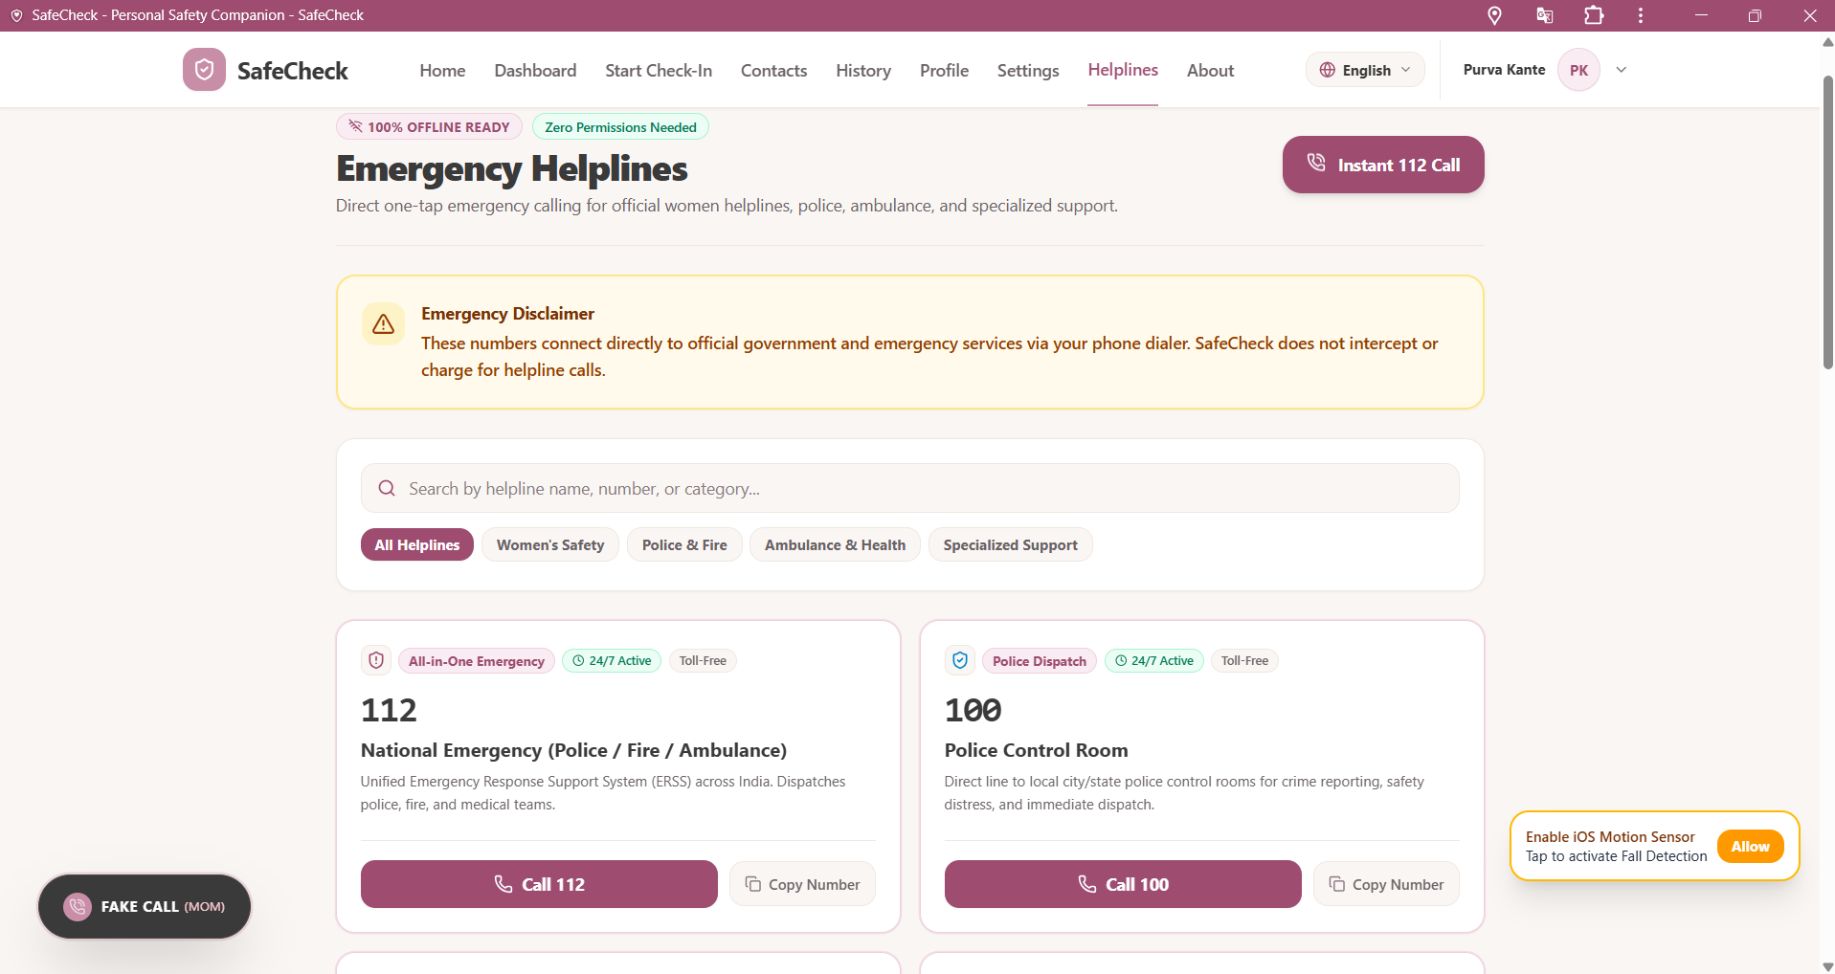
History & Emergency Helplines
A full trip log for peace of mind, plus one-tap access to official emergency numbers — fully offline-ready.
Trip & Safety Log — arrivals, alerts, and SOS events at a glance
Emergency Helplines — direct dial to police, ambulance & women's safety lines
SafeCheck • Personal Safety Companion
8

Slide 9
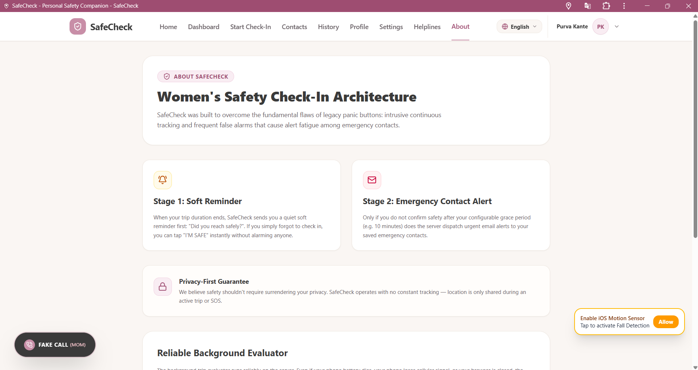
How It Works
A two-stage architecture designed to eliminate false alarms without sacrificing safety.
1
2
Soft Reminder
Emergency Contact Alert
When the trip timer ends, SafeCheck sends a gentle prompt: “Did you reach safely?” One tap confirms it.
Only if you don't confirm within the grace period does SafeCheck escalate a live-location alert to your circle.
Privacy-first, always. No constant tracking — location is shared only during an active trip or SOS.

Slide 10
.
Thank you
SafeCheck — Personal Safety Companion

